Slide 2
Unit 5: Functions (6hrs)
Introduction
Importance of functions
Returning a value from a function and sending a value to a function
Function prototypes
Calling a function- Call by value and Call by reference
Recursive functions
Passing an array to a function
Local variables, formal parameters, and global variables
Storage classes
Pre-processor directives- C libraries, macros, and header files

Slide 3
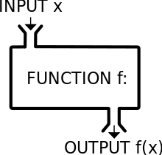
Function
A function is a self-contained block of statements that performs a particular specified task in a program.
When the functions are called through the main() or other calling procedure, the functions perform their task.

Slide 4
Advantages of function
Manageability
Code Reusability
Logical clarity
Minimize workload

Slide 5
User-defined Vs Library Function
Defined by user.
User puts the name, return-type, and arguments themselves.
Eg:
add()
main()
Built-in functions
Already available functions in C-library.
Eg:
print()
scanf()
pow()

Slide 6
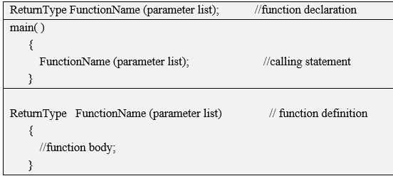
Structure of a Function

Slide 7
Components of a function
Function declaration
Function definition
Function call
Function arguments/parameters
Return statement

Slide 8
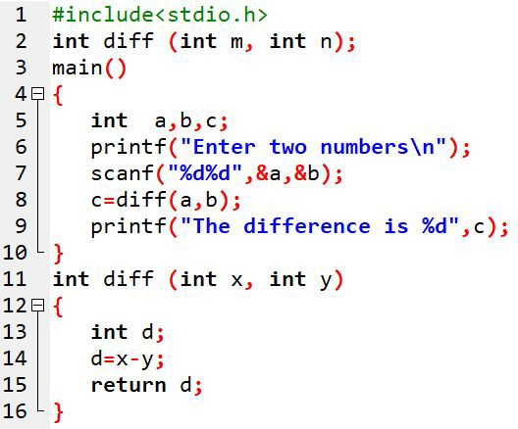
Components of a function
Function declaration
Function call
Function definition
Arguments/parameters Return statement

Slide 9
Classification of Function
Function with no arguments and no return value
Function with no arguments but return value
Function with arguments but no return value
Function with both arguments and return value

Slide 10
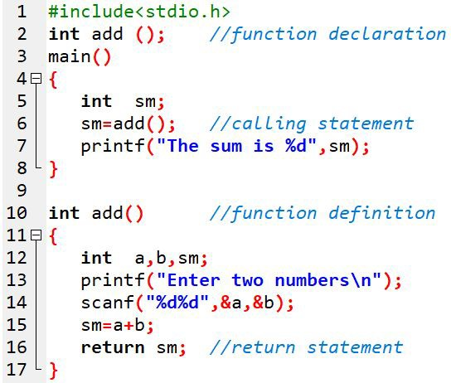
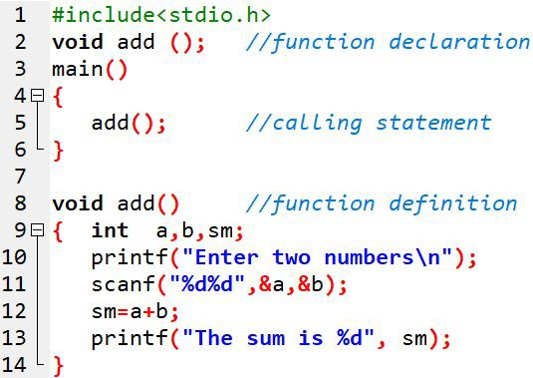
Classification of Function
1. Function with no arguments
and no return value
2. Function with no arguments
but return value

Slide 11
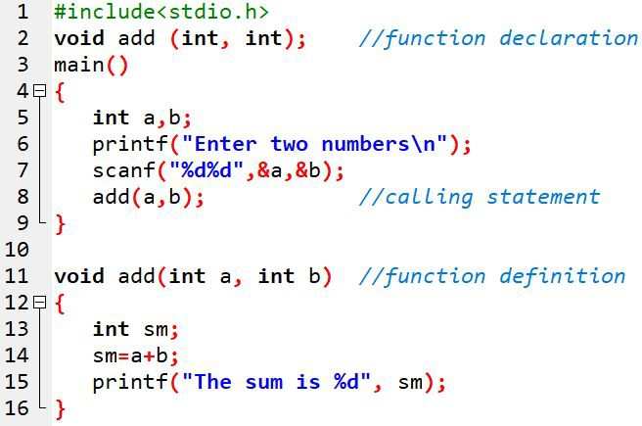
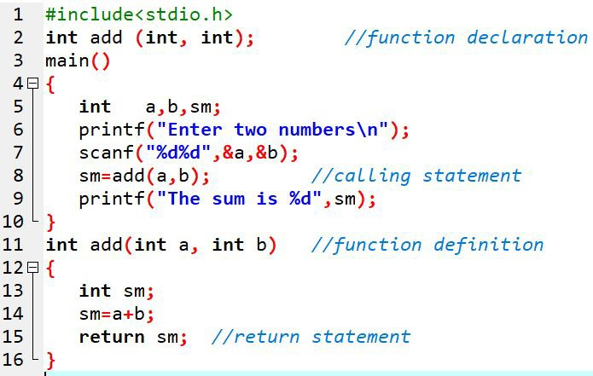
Classification of Function
3. Function with arguments but
no return value
4. both arguments and return value

Slide 12
Ways Of Passing Arguments To The Function
Passing by Value
Passing by reference

Slide 13
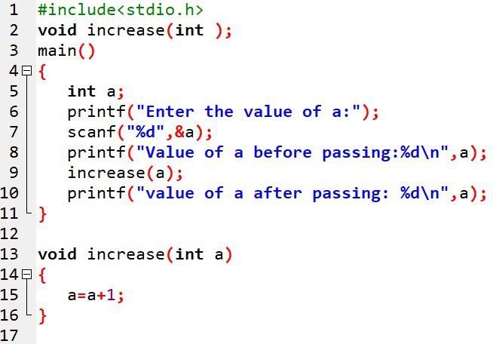

Passing by Value
Only the value is passed
One-way transfer of information
Any change made in the called function does not make a change in the calling function.
Advantage: original value remains unchanged
Disadvantage: only one return value is possible at a single time

Slide 14
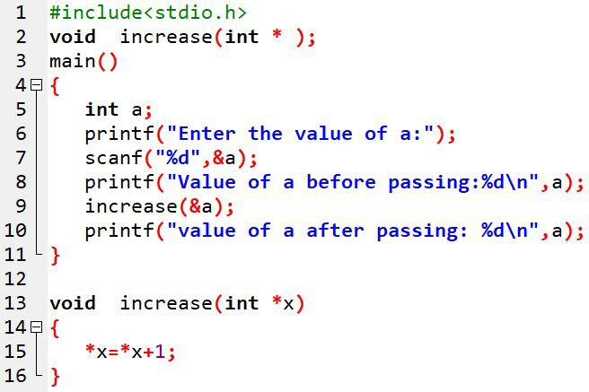

Passing by Reference
The address itself is passed
Two-way transfer of information
Any change made in the called function changes the calling function.
Advantage: multiple value return possible
Disadvantage: Alteration of original value

Slide 15
Recursive Function
A function that calls to itself.
It is done to solve a smaller version of its tasks until a final call which does not require a self-call.
Thus, a function that calls itself is known as a recursive function and this technique is called recursion.
Many iterative or repetitive problems can be written in recursive form.

Slide 16
Recursive Function
Base Criteria:
Each time a function calls itself, it must be closer to a solution.
There must be a decision criterion for stopping the process, also called a base criterion.

Slide 17
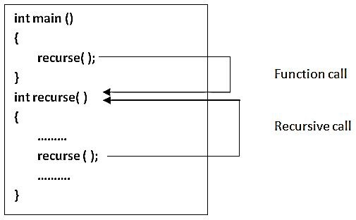
Basic Structure Of Recursion

Slide 18
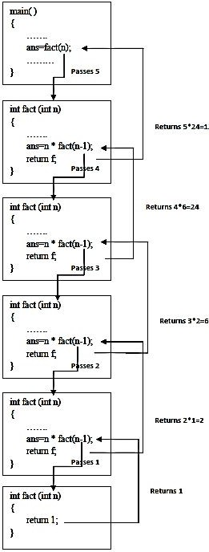
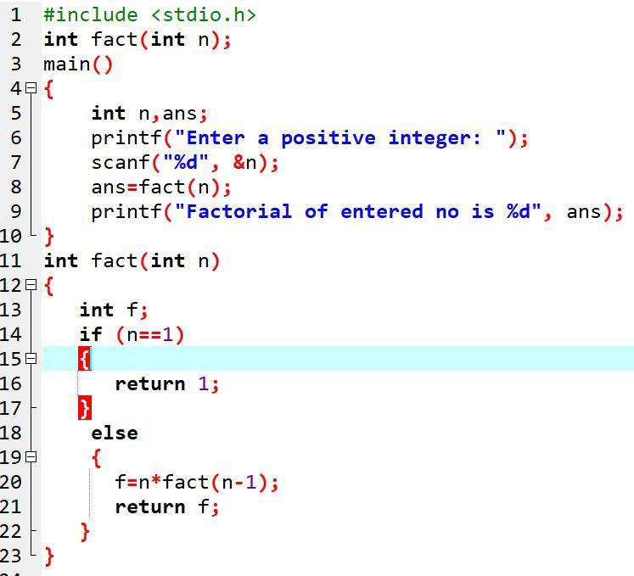
WAP using recursion to enter a number and find its factorial.

Slide 19
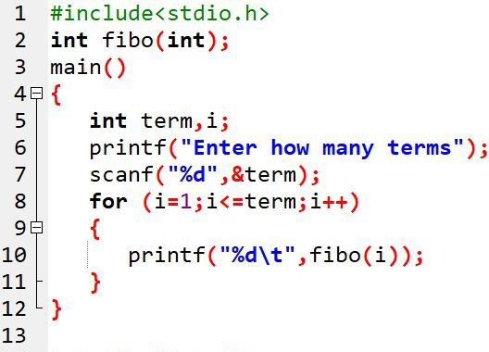
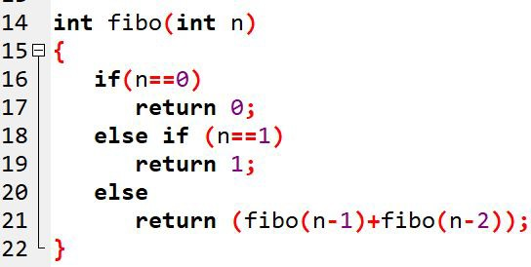

WAP using recursion to print Fibonacci series up to n^{th} terms.

Slide 20
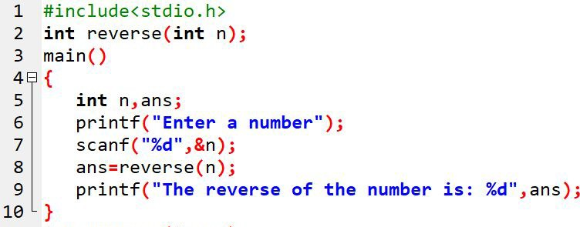
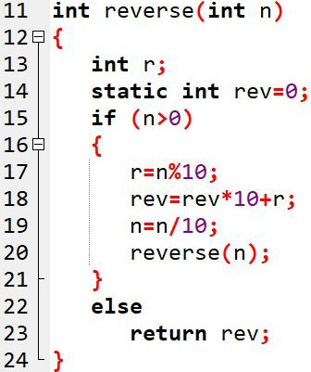

WAP to input any positive integer and find its reverse using recursion.

Slide 21
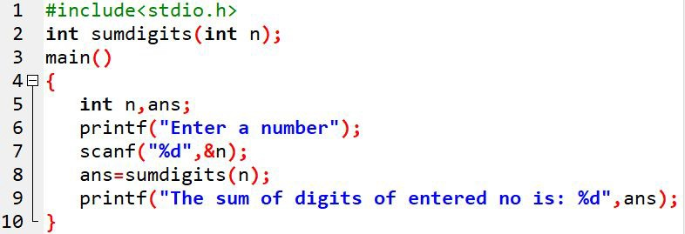
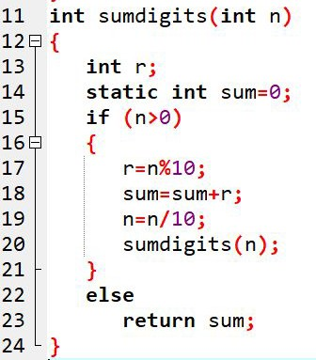

WAP to input any positive integer and find the sum of digits in it.

Slide 22
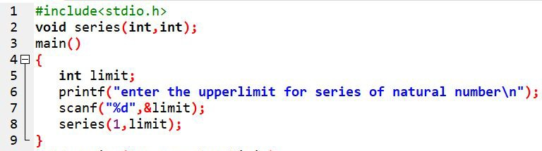
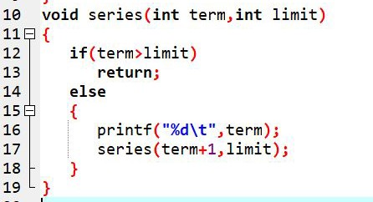

WAP to find the sum of n natural numbers using recursion.

Slide 23
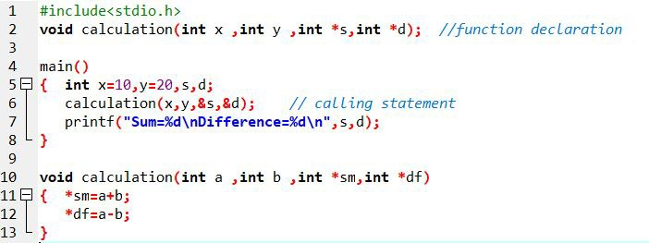

Returning multiple values by function
We can return multiple values to the calling function by the use of address operator (&) and indirect operator (*).

Slide 24
End of Lecture 11

Slide 25
Passing Array to Function Storage Directives

